Slide 1
Testing

Slide 2
Lesson Objectives
Discuss the importance of a complete test suite
Define the differences between unit, integration, and end-to-end testing
Create unit tests to achieve a specified code coverage level
Utilize fixtures and mocks to implement unit tests

Slide 3
Why Test?
Why is testing important?

Slide 4
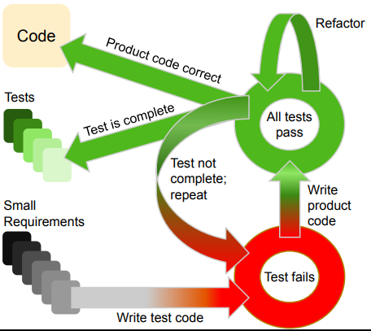
Test Driven Development
Different mindset of software development
Requirements → tests → code
Typically done in red-green-refactor phases
Write a failing test
Write code until the test passes
Refactor the code to cleanup

Slide 5
Testing Types
Functional
Unit tests
Integration tests
End-to-end tests
Acceptance
Non-functional
Security
Performance
Usability
Compatibility

Slide 6
Unit Tests

Slide 7

Unit Testing
Is your house stable if the lumber is rotted?
Smallest piece of testable code : unit
Benefits
Helps ensure correctness
Catch problems early
Fast

Slide 8
Unit Testing / Reqts. Framework
Given – When – Then
Given: The initial conditions / prerequisites
When: The action or event to be verified
Then: The outcomes of the action or event
Useful for formulating unit tests based on requirements
Used to communicate with non-technical stakeholders
Tests should be complete, independent, reproducible, and small!!

Slide 9
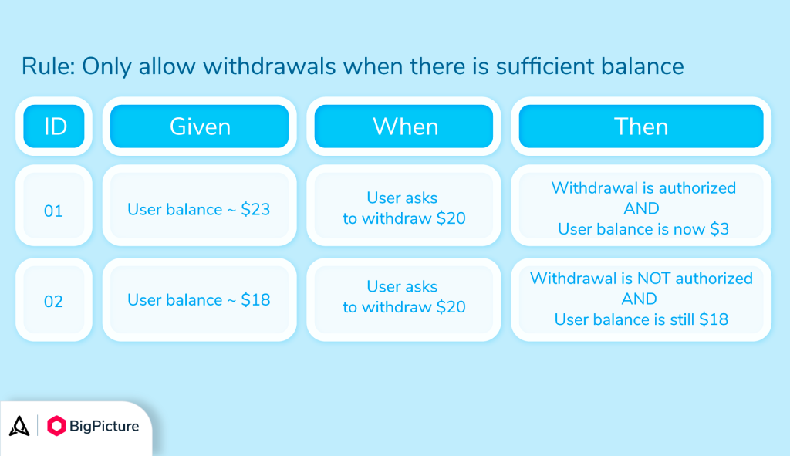

Slide 10
Testing in Python
def add(a, b):
return a + b
def test_add():
assert add(1, 2) == 3
assert add(0, 5) == 5
def test_add_negative():
assert add(-5, -7) == -12
assert add(-5, 5) == 0
Pytest / unittest / doctest
Each has their own pros/cons
Assert statement
Notes:
How would you write “given, when, then” for the code on the right?

Slide 11
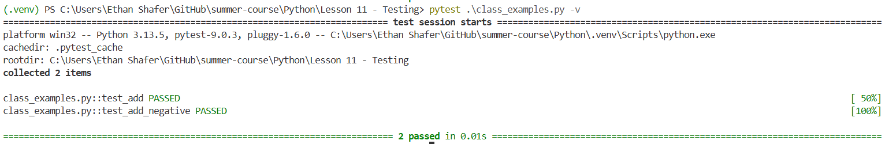
PyTest
def add(a, b):
return a + b
def test_add():
assert add(1, 2) == 3
assert add(0, 5) == 5
def test_add_negative():
assert add(-5, -7) == -12
assert add(-5, 5) == 0
A separate package / command
Generally auto-discovers tests
Can also give specific files
pip install pytest
pip install pytest-cov

Slide 12
Pytest Example
Temperature conversion
Scenario 1
Given a temperature of 0C
When I convert to F
Then I should get 32F
Scenario 2
Given a temperature of 100C
When I convert to F
Then I should get 212F
Scenario 3
Given a temperature of -40C
When I convert to F
Then I should get -40F
Scenario 4
Given a temperature of -300C
When I convert to F
Then I should get an error!

Slide 13
Hands-On #1

Slide 14
Other Testing Ideas

Slide 15
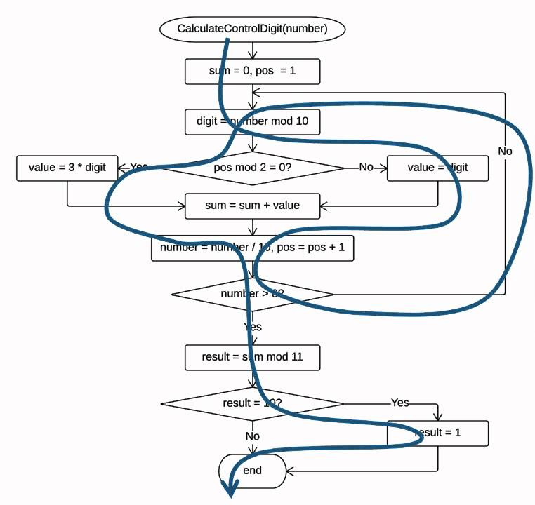
Completeness
Control flow statements create branches
Are we covering every path?
How much coverage is appropriate?
Generally ~80%, domain dependent

Slide 16
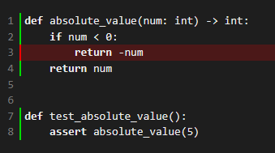
Small Example
def absolute_value(num: int) -> int:
if num < 0:
return -num
return num
def test_absolute_value():
assert absolute_value(5)

Slide 17
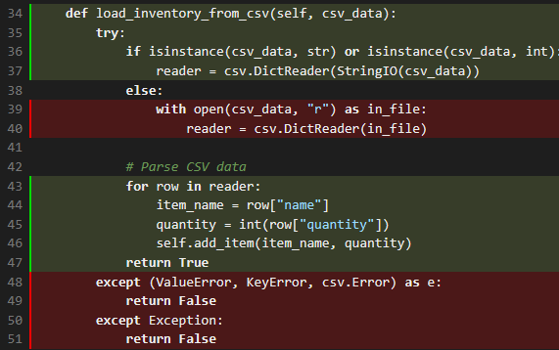
Larger Example
Inventory class
pytest --cov=inventory --cov-report=term-missing --cov-report=html
What could be hiding in this coverage?
Notes:
Line 36 of inventory.py might be "covered" but you need to be careful about the 'or' statement

Slide 18
Another Example
def sin(num: int) -> int:
return 0
def test_sin():
assert sin(0) == 0
Tests should be complete, independent, reproducible, and small!!

Slide 19
DRY
Case 1:
Consistent config / setup
Consistent parameters
Case 2:
Input data generally stays the same
Multiple functions might need the same inputs
Have to write the same input data for each test?
Case 3:
Specific objects might take a while to instantiate
We want our tests to be fast
Preload those objects

Slide 20
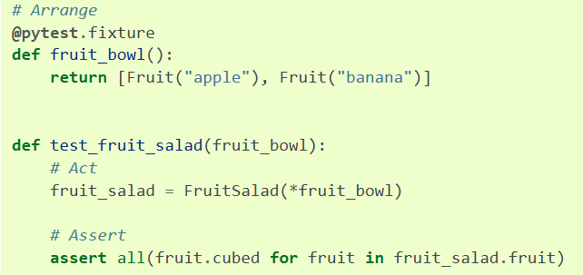
Fixtures
Notes:
https://docs.pytest.org/en/7.1.x/how-to/fixtures.html

Slide 21
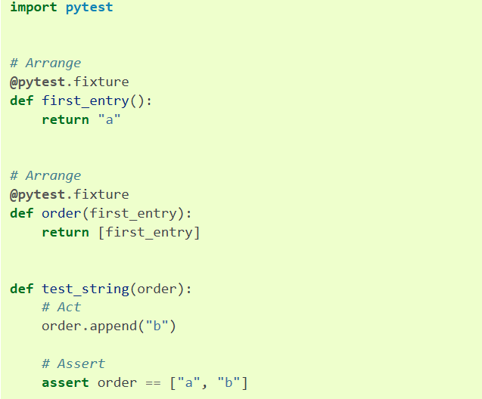
Fixtures
Notes:
Fixtures are cached but side effects are not kept

Slide 22
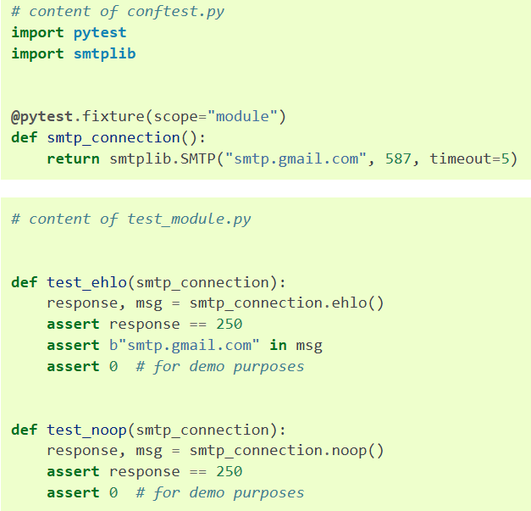
Fixtures
Notes:
This fixture is shared and not created multiple times

Slide 23
Mocking External References
import requests
def get_user_name(user_id):
"""Fetch a user's name from an API."""
response = requests.get(f"https://api.example.com/users/{user_id}")
if response.status_code == 200:
return response.json().get("name")
return None

Slide 24
Mocking External References
import pytest
from http import get_user_name
def test_get_user_name_success(mocker):
"""Test get_user_name with a mocked requests.get"""
# Create a mock response object
mock_response = mocker.Mock()
mock_response.status_code = 200
mock_response.json.return_value = {"name": "Alice"}
# Patch requests.get to return our mock response
mocker.patch("app.requests.get", return_value=mock_response)
# Call the function under test
result = get_user_name(123)
# Assertions
assert result == "Alice"
app_requests_get = mocker.patch("app.requests.get")
app_requests_get.assert_called_once_with("https://api.example.com/users/123")

Slide 25
Hands-On #2

Slide 26
Questions

